Slide 1
FILTERING OF ACOUSTIC INFORMATION FROM AERO-OPTICAL MEASUREMENTS
Brian Catron

Slide 2
Contents
Basic Aero-Optics
Optical-Acoustic Coupling
Multidimensional Spectral Estimation
Filtering of Optical Wavefronts
Conclusions and Recommendations

Slide 3
Basic Aero-Optics

Slide 4
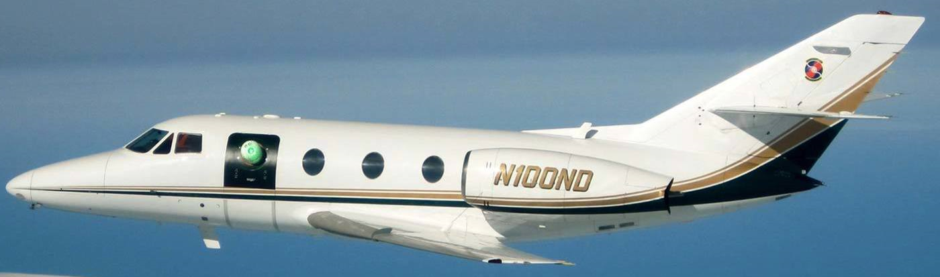
Farfield Performance
An optical system’s farfield performance is affected by three main components
Diffraction
Nearfield Disturbances
Distributed Disturbances

Slide 5
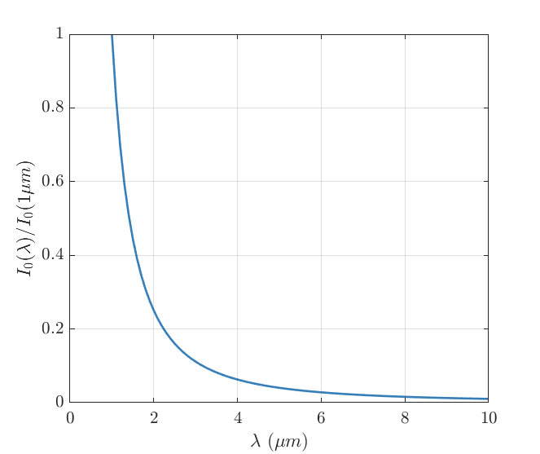
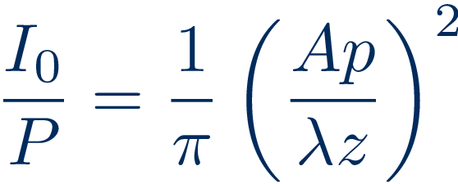
Diffraction
A perfect optical system will have degradation due to diffraction
There is a strong desire to move towards systems operating at a shorter wavelength
Notes:
Equation 1.2 - \frac{I_0}{P} = \frac{1}{\pi}\left(\frac{Ap}{\lambda z}\right)^2

Slide 6
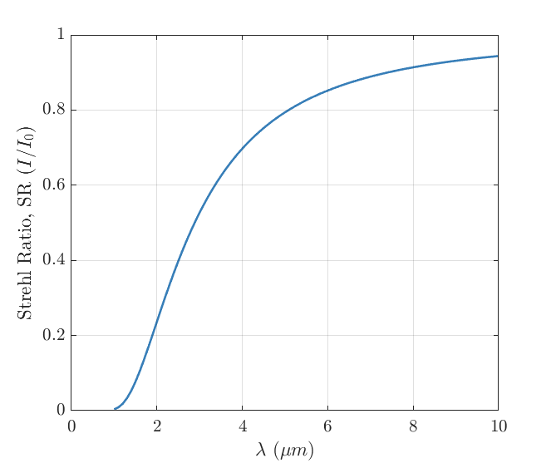
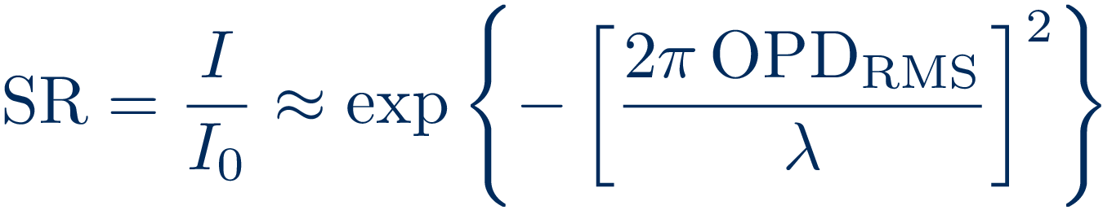
Nearfield Disturbances
First order estimate of the farfield performance due to nearfield disturbances
In order to move to these shorter wavelengths OPD_{RMS} must be reduced as much as possible
Notes:
Equation 1.1 and 1.3 - \sr = \frac{I}{I_0} \approx \exp\left\{-\left[\frac{2\pi \opdrms}{\lambda}\right]^2\right\}

Slide 7
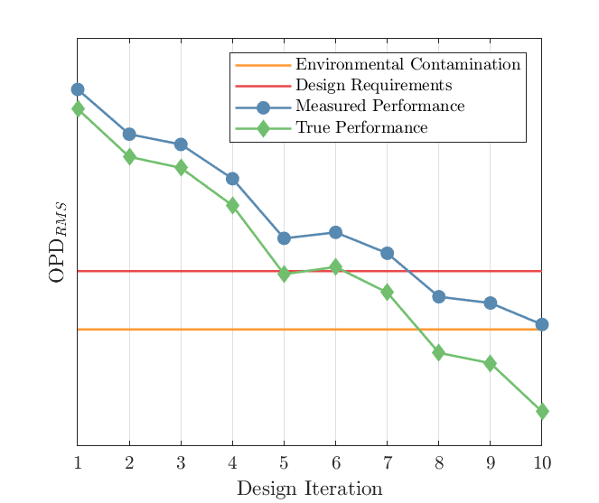
Future System Development
As the future airborne directed-energy systems are developed the environmental contamination of the test facility must be accounted for
Notes:
Equation 1.4 - \opdrms_{TOTAL}^2 = \opdrms_{MODEL}^2+\opdrms_{ENVIRONMENT}^2

Slide 8
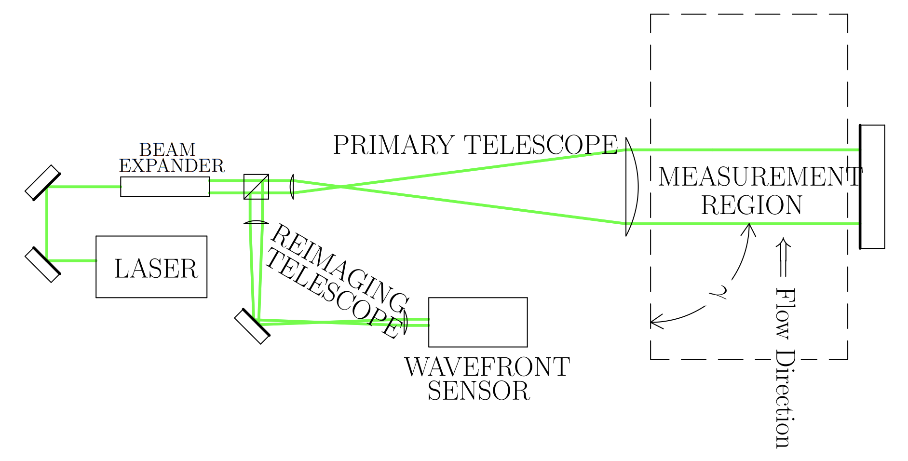
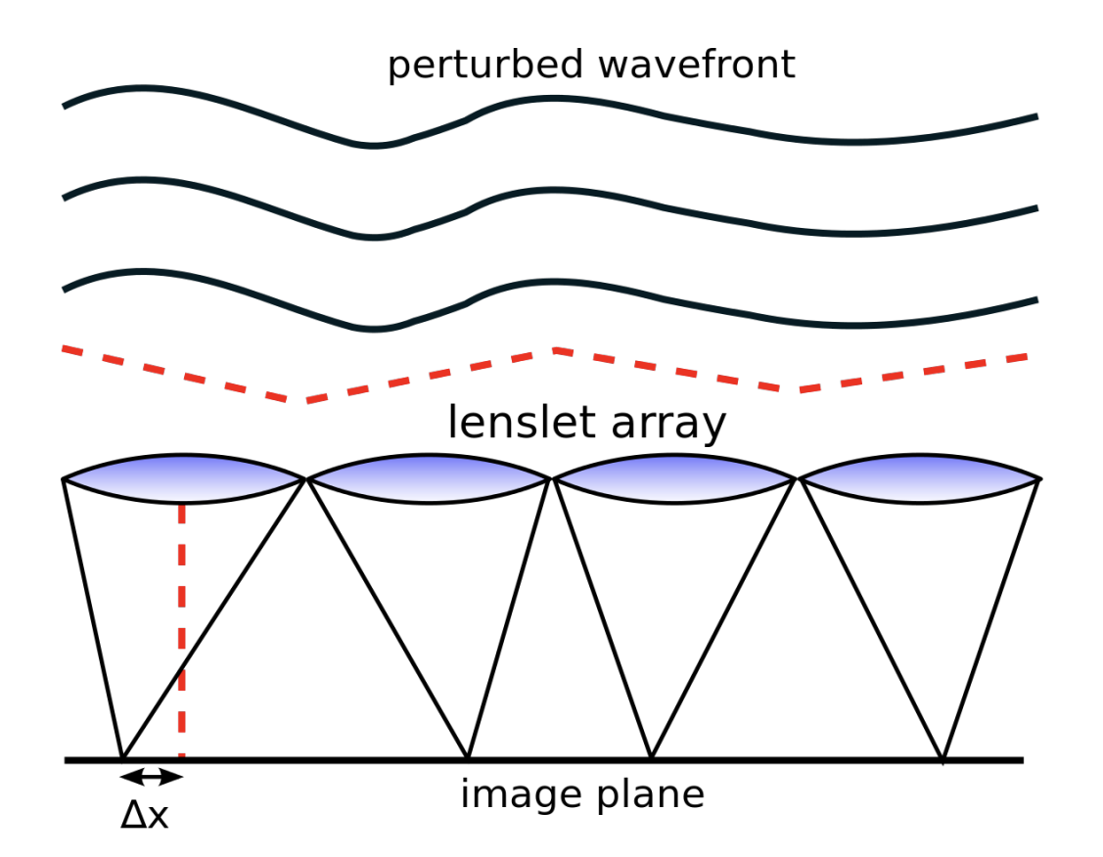
Typical Measurement Setup
Double-pass Shack-Hartmann Wavefront Sensor
Optical disturbance is imprinted twice
Wavefront is computed by measuring a focal point displacement at each lenslet

Slide 9
Optical-Acoustic Coupling
Notes:
One important source of contamination is acoustic noise

Slide 10
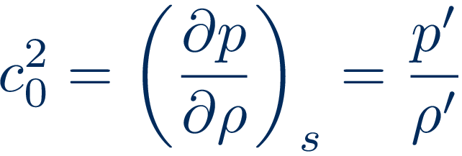
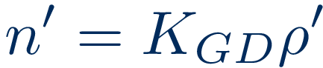
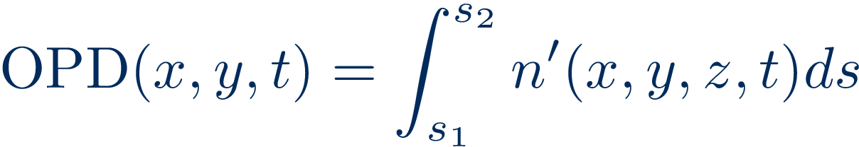
Sound to Index-of-Refraction
The definition of the speed of sound gives the relationship between pressure and density fluctuations in an acoustic wave
These density fluctuations can be related to index-of-refraction fluctuations via the Gladstone-Dale constant
Integrating over a beam propagation path through a fluctuating index-of-refraction field results in the optical path deference
Notes:
Equation 3.2 - c_0^2 = \left(\frac{\partial p}{\partial \rho}\right)_s=\frac{p'}{\rho'}
Equation 2.5 - n'=K_{GD}\rho‘
Equation 2.8 - \opd(x,y,t) = \int^{s_2}_{s_1} n'(x,y,z,t)ds

Slide 11
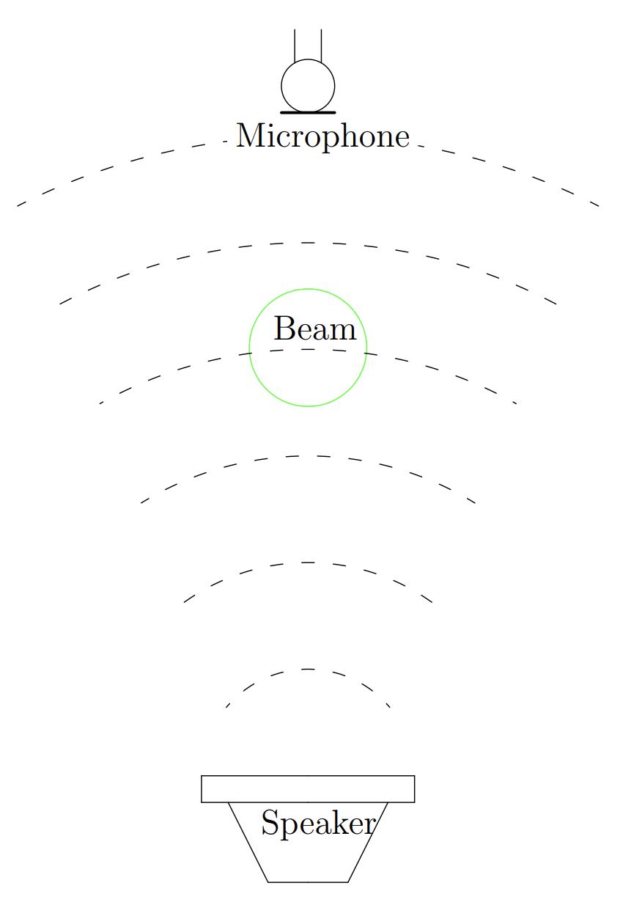
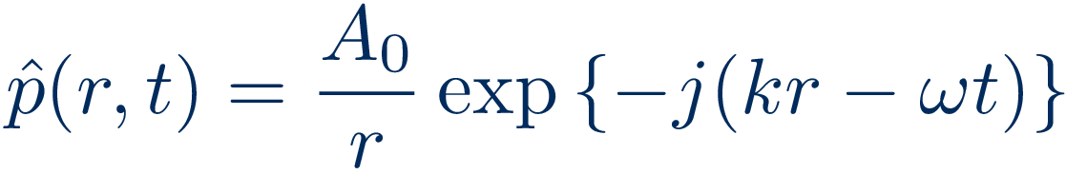
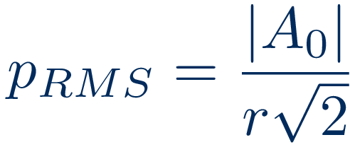
Spherical Wave
The acoustic field from a speaker can be assumed to be a spherical wave emanating from a pulsating point
The RMS pressure at any given point
Notes:
Equation 3.12 – \hat{p}(r,t) = \frac{A_0}{r}\exp\left\{-j(kr-\omega t)\right\}
Equation 3.13 – p_{RMS} = \frac{|A_0|}{r\sqrt{2}}
Figure 3.7
Add notation to figure

Slide 12
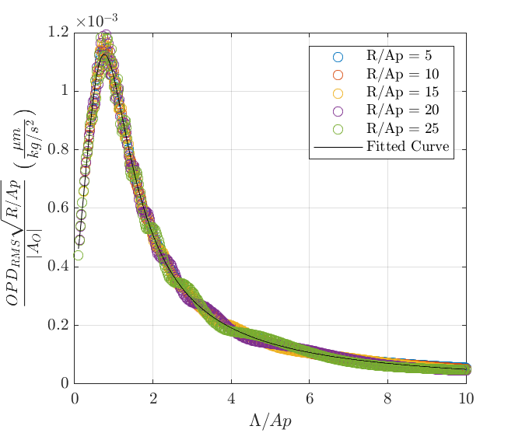
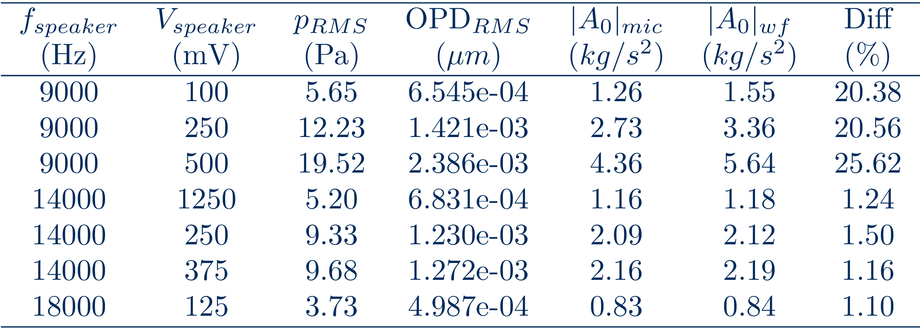
OPD_{RMS} to A₀
Simulated Results
Measured Results
Good agreement between microphone and wavefront measurements of |A₀|
Notes:
Figure 3.6
Table 3.2
Figure 3.8

Slide 13
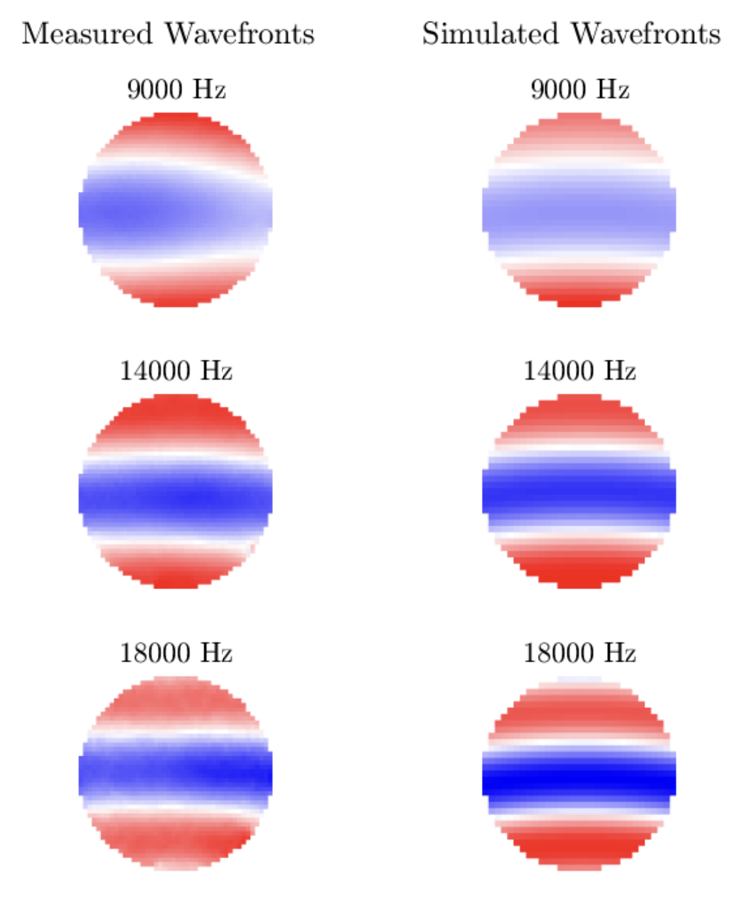
What happened at 9kHz?
The measured wavefront differed significantly from spherical
Likely due to the speaker not acting like a piston
All of the higher frequency test points have an acoustic field that resembles a spherical wave

Slide 14
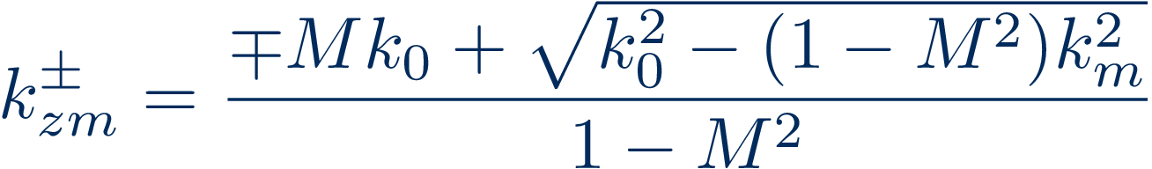
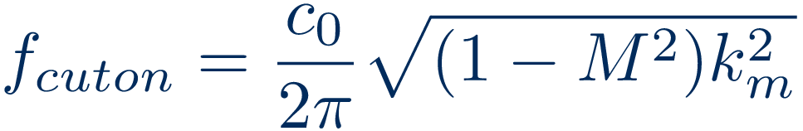
Duct Acoustics
Acoustic waves within a duct are governed my the cross-section
An acoustic mode, m, has a characteristic cross-section wavenumber k_{m}, and axial wavenumbers based on Mach number
Each mode has a cuton frequency below which it will exponentially decay

Slide 15
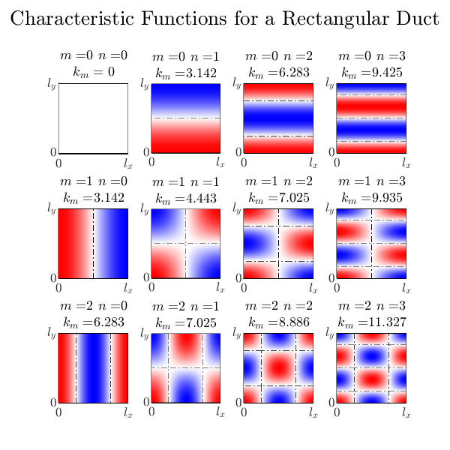
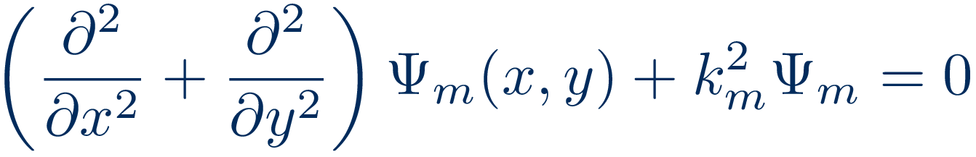
Acoustic Duct Modes
The mode shapes are eigen-function solutions of
Known analytical solutions for circular and rectangular ducts but arbitrary shapes must be numerically solved

Slide 16
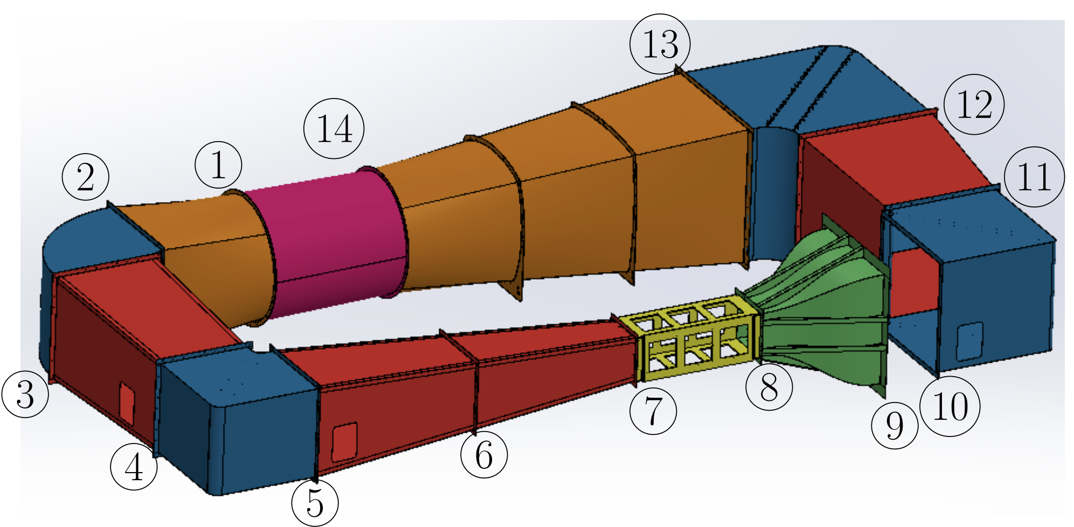
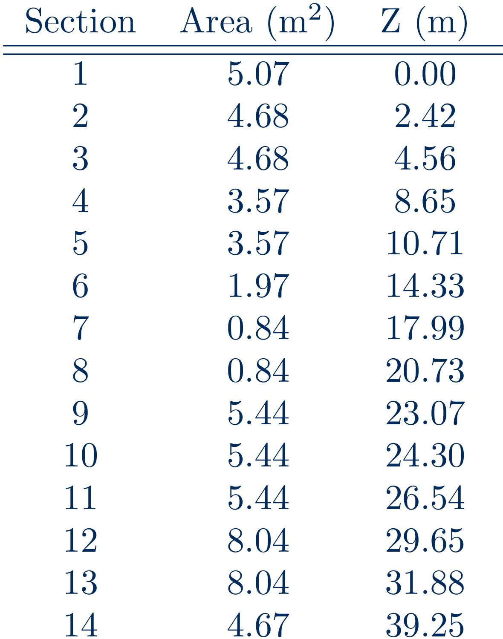
Wind Tunnel Fan Noise
Mode Marching Method to follow acoustic duct modes originating from the fan and passing into the test section
A quasi-1D model of the Whitefield M=0.6 tunnel was used
Notes:
Figure 3.11

Slide 17
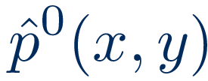
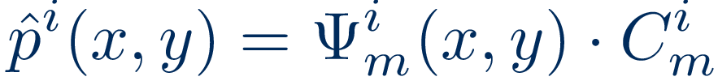
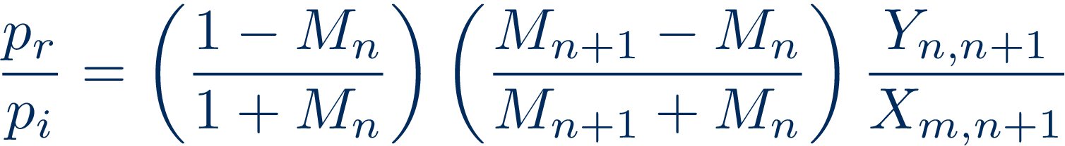
Mode Marching Method
Starting Pressure Disturbance
Modal Best Fit
Transmitted Pressure Ratio
Reflected Pressure Ratio
March Modes Forward
Repeat 2-5 as Necessary

Slide 18
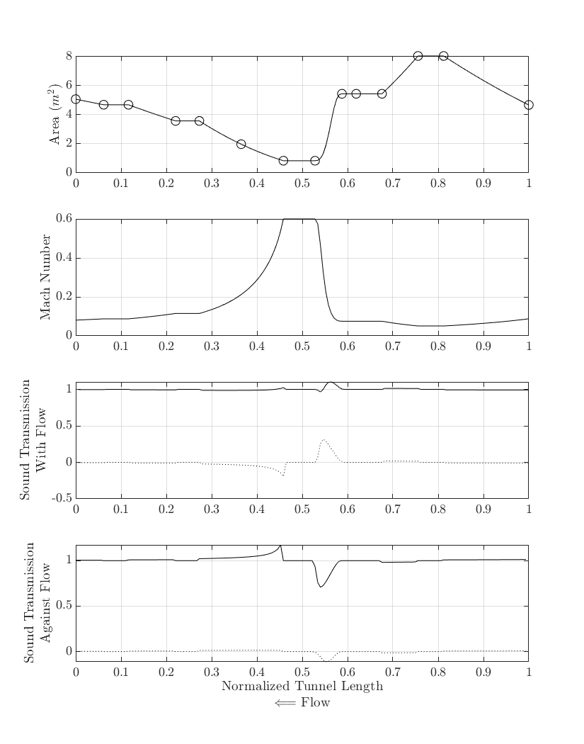
Tunnel Discretization
0.25m max distance between steps
Isentropic flow relations used to estimate the Mach number throughout the tunnel
Reflected waves (dotted line) are negligible throughout the tunnel except for either side of the test section

Slide 19
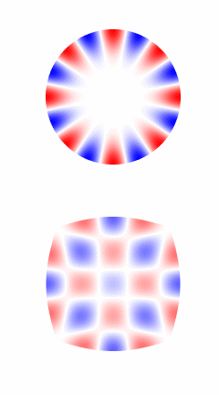
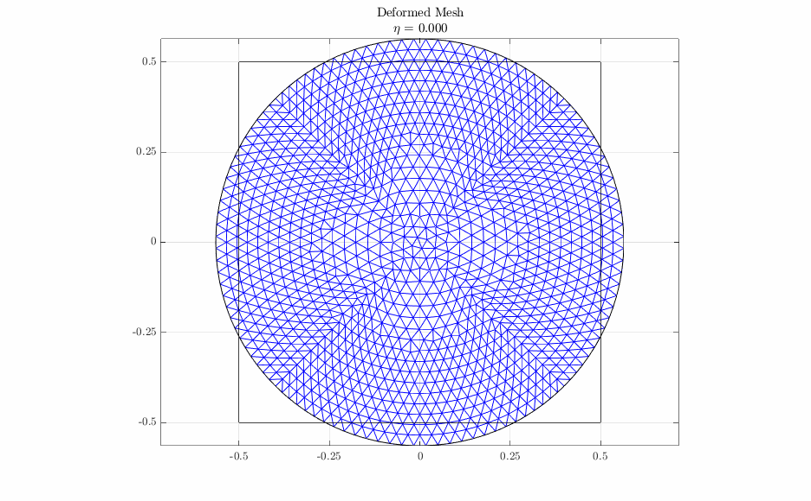
Round to Square Transition
A deformable mesh was used to allow for a 1-to-1 mapping of all points from one location to the next
Fan Acoustic Disturbances
Halfway Through Transittion
Notes:
~Figure 3.9
~Figure 3.12

Slide 20
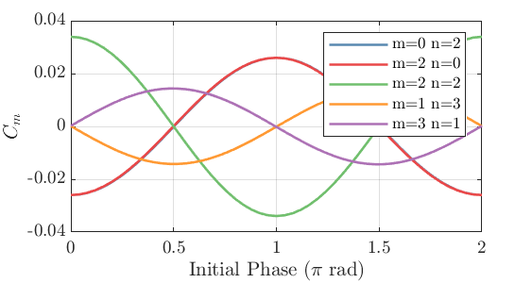
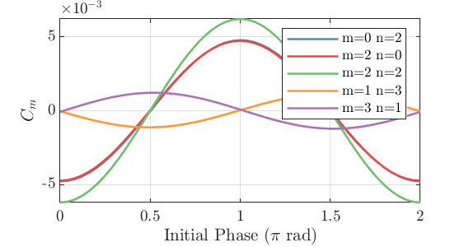
Test Section Acoustic Field
An empty test section is comprised of 5 duct modes due to the tunnel fan
The upstream traveling acoustic modes are an order-or-magnitude greater amplitude than the downstream traveling
Upstream Traveling
Downstream Traveling
Notes:
Figure 3.14
Figure 3.15

Slide 21
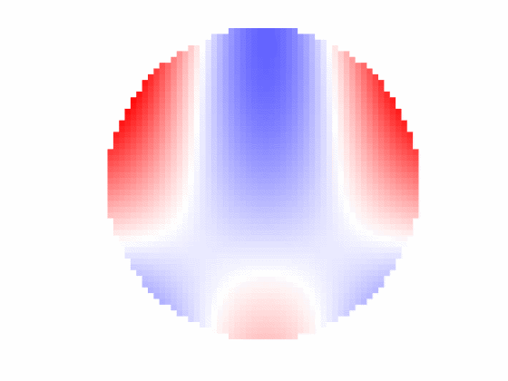
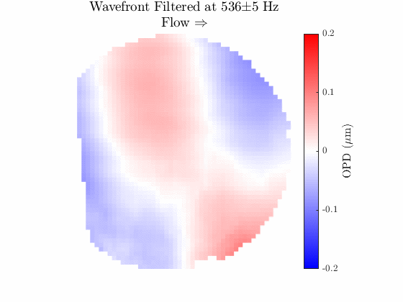
Comparison to Measured Data
Simulated Wavefront
Measured Wavefront

Slide 22
Multidimensional Spectral Estimation

Slide 23
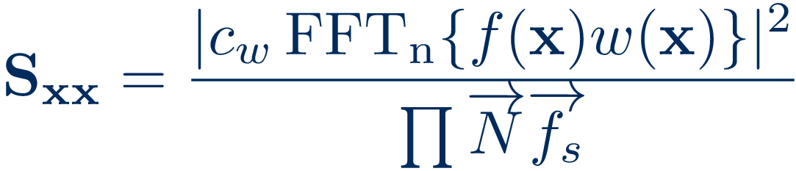
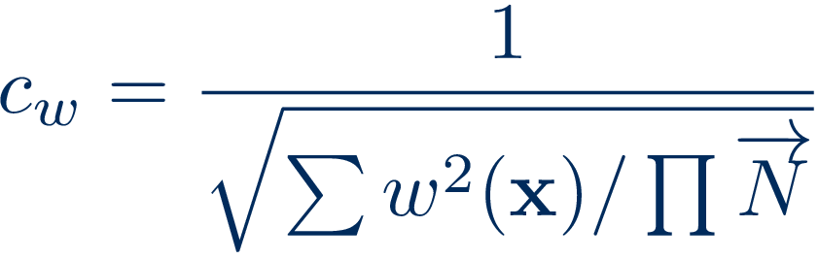
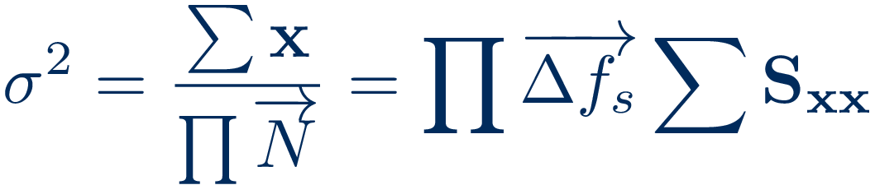
Power Spectra in N-Dimensions
Spectral information in time and space simultaneously
Windowing function was a temporal window multiplied by the spatial window
Spatial window used a modified Hann window
Notes:
Equation 4.11 – \mathbf{S_{xx}} =\frac{|c_w\fftn\{f(\mathbf{x}) w(\mathbf{x})\}|^2}{\prod{\overrightarrow{N}\overrightarrow{f_s}}}
Equation 4.12 – c_w = \frac{1}{\sqrt{\sum w^2(\mathbf{x})/\prod{\overrightarrow{N}}}}
Equation 4.13 – \sigma^2=\frac{\sum\mathbf{x}}{\prod{\overrightarrow{N}}} = \prod{\overrightarrow{\Delta f_s}}\sum\mathbf{S_{xx}}

Slide 24
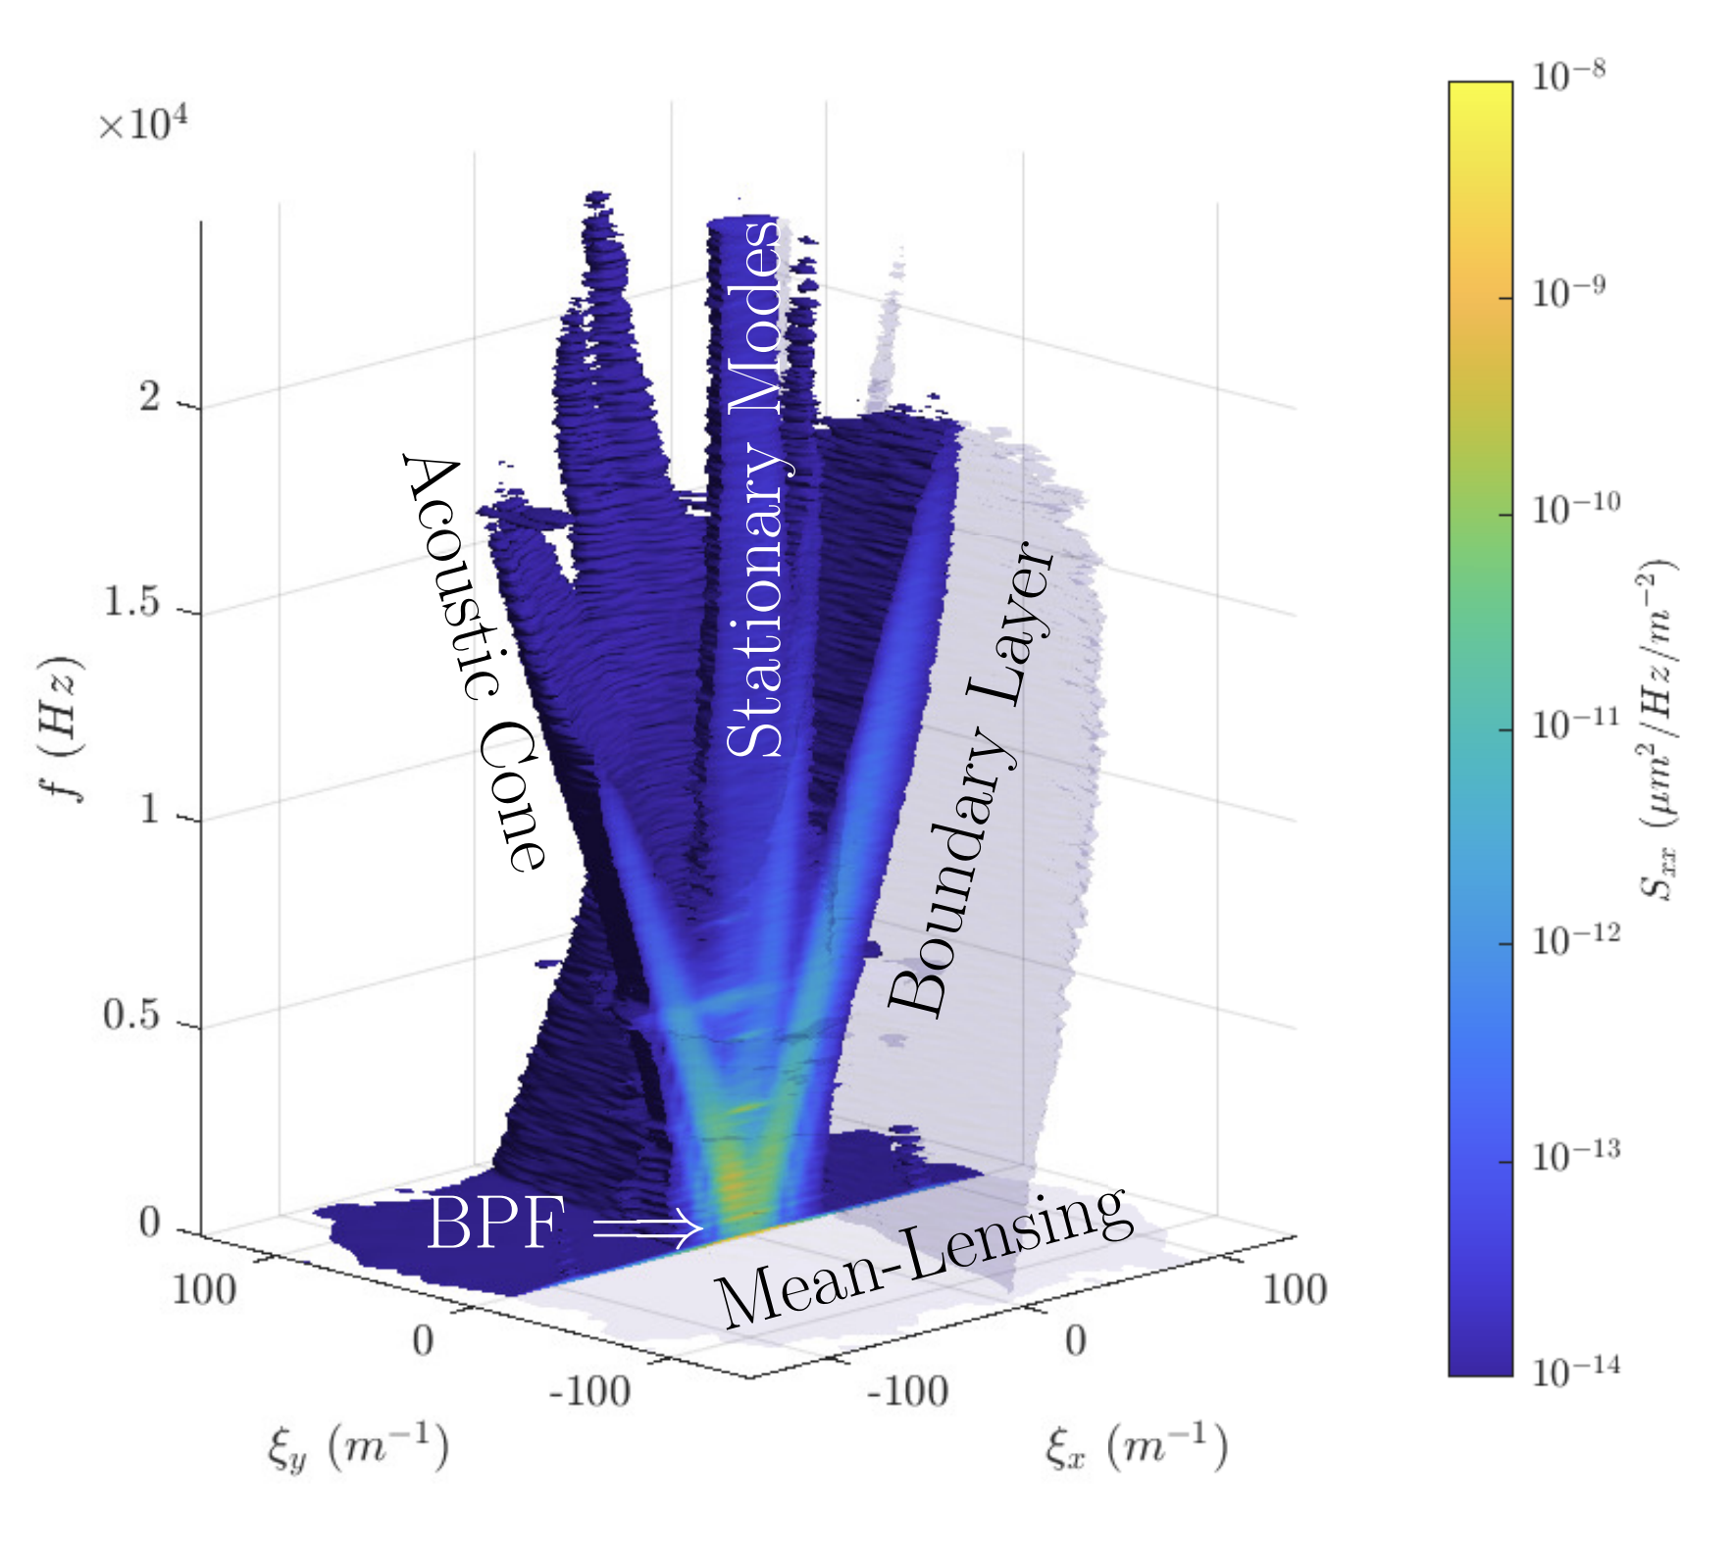
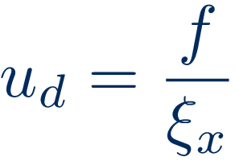
Cut Isosurface
Optical disturbance structures become evident
The narrow band temporal signals have a significant broad band spatial signals
Notes:
Add dispersion equation

Slide 25
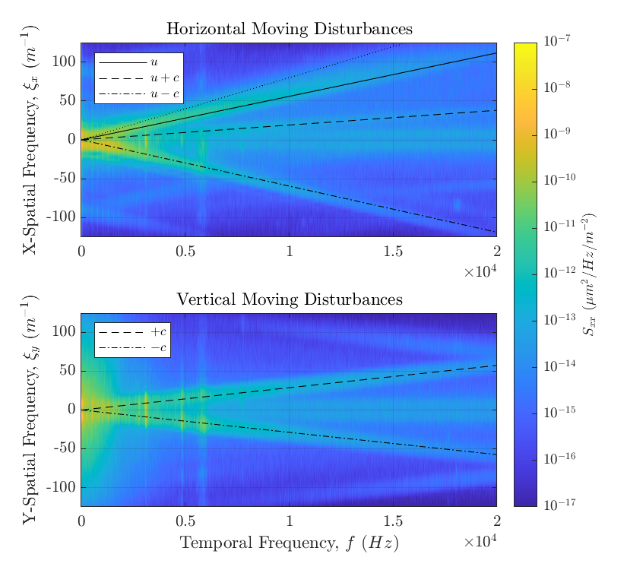
Plane Waves moving in X & Y
Disturbances move at the characteristic velocities: u, u±c
The slope of the lines are 1/v
Notes:
Figure 4.4

Slide 26
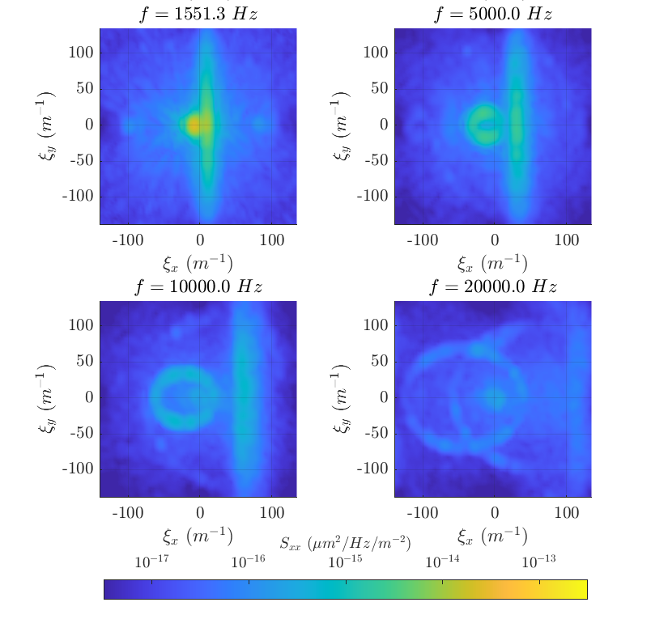
Slices in Frequency
Boundary Layer is rotated slightly counter-clockwise
The boundary layer signal has a sharp drop in power at u
The acoustic signal has some noticeable signal aliasing
Notes:
Figure 4.10

Slide 27
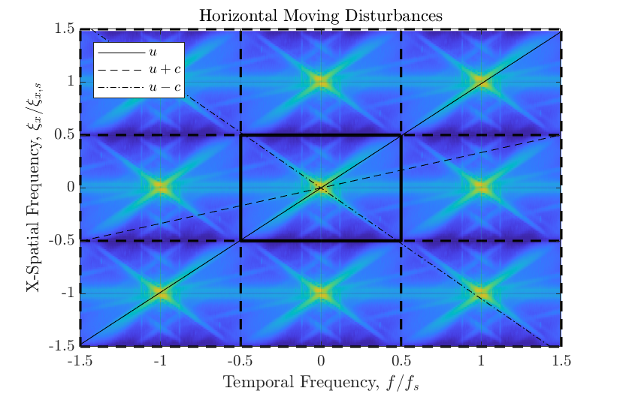
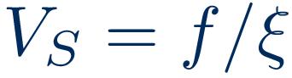
Signal Aliasing
Tiling the spectrum can help identify aliased signal
Sample velocity, , needs to be sufficiently different from a measured velocity to identify aliasing

Slide 28
Wavefront Filtering

Slide 29
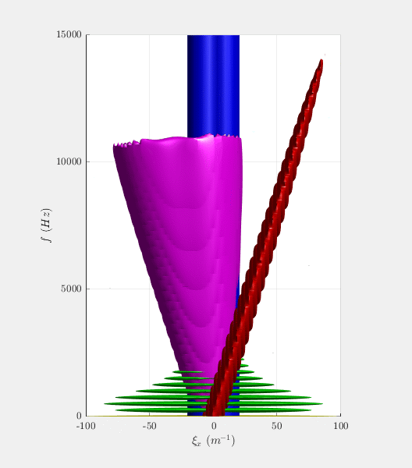
Synthetic Wavefront & Basic Filtering
For testing the performance of various filters a fully known signal needed to be generated
Two synthetic wavefronts were created, a BL only one and one with all disturbances
Filters are applied in spectral space and converted back to physical space
Notes:
Equation 6.1 – f_F(\mathbf{x}) = \real\left(\ifftn[H(j\mathbf{\omega})\fftn\{\mathbf{x}\}]\right)

Slide 30
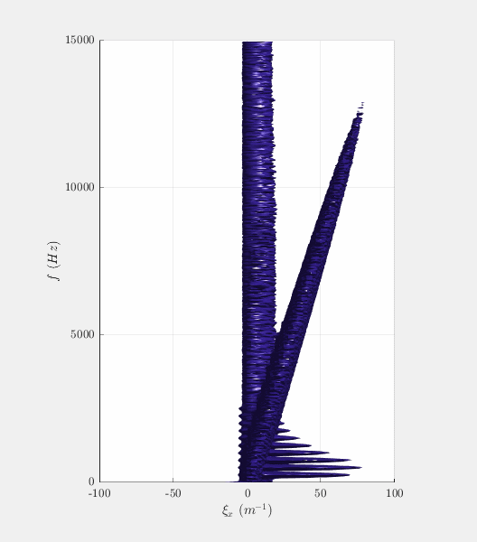
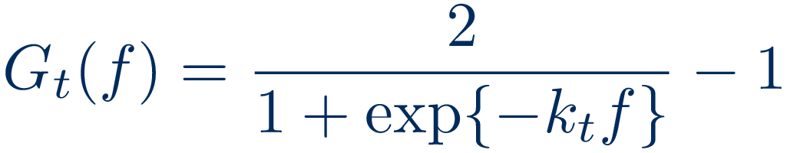
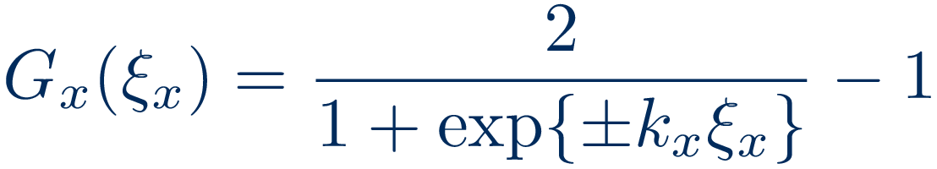
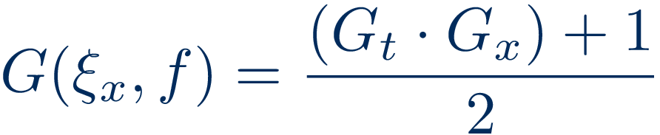
Upstream/Downstream Filter
Filter removes all of the signal that is traveling in a given direction
Can remove a significant portion of the acoustic signal
Notes:
Equation 6.5 –
Equation 6.6 –
Equation 6.7 –

Slide 31
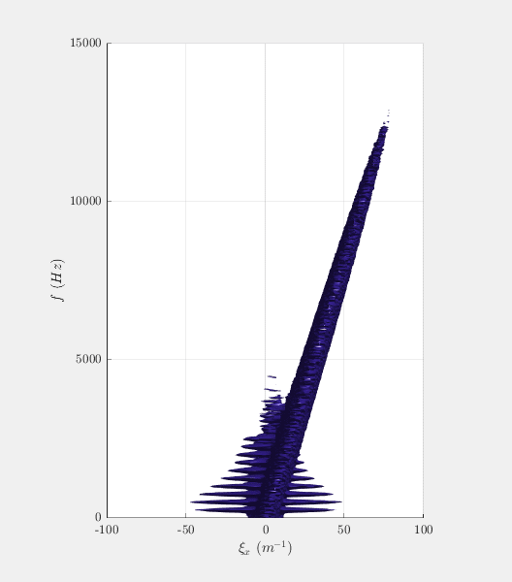
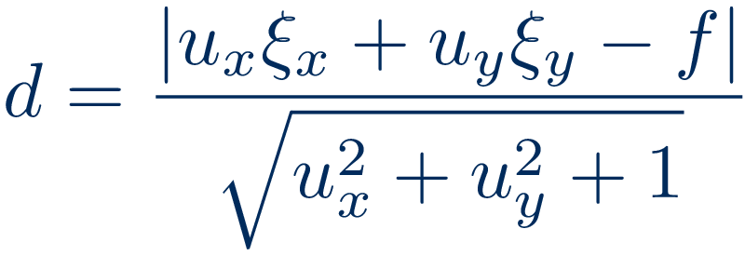
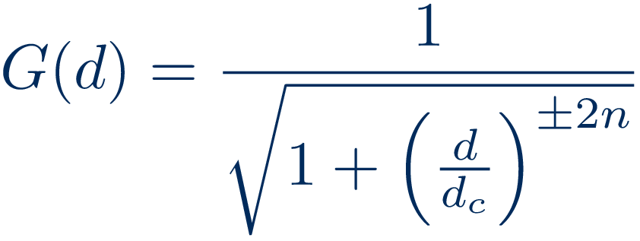
Velocity Filter
Low-pass filter based on the distance of a point in spectral space to the plane representing the velocity
Can also be used to measure the disturbance velocity
Notes:
Equation 6.8 –
Equation 6.9 –

Slide 32

Baseline Filter
Filter algorithm developed for analysis of Raman spectra
Applied along f at each ξ bin
The more narrow a signal spike the more likely it will be filtered out
b: baseline spectrum m: measured spectrum
H. G. Schulze, R. B. Foist, K. Okuda, A. Ivanov, and R. F. B. Turner. A small-window moving average-based fully automated baseline estimation method for raman spectra. Applied Spectroscopy, 66(7):757–764, 2012. doi: 10.1366/ 11-06550.
Notes:
Equation 6.12 –
Figure 6.7 –
x: underlying signal vector
p: instrumental blurring function
n: measurement noise

Slide 33

LSE-SPOD
Uses accelerometers and microphones to filter SPOD modes using Linear Stochastic Estimation
While it had similar results as previous studies, it did not significantly reduce the narrowband disturbances

Slide 34


Filter Combinations
Combined filters take advantage of the strengths of the parent filters
Estimated BL OPD_{RMS}: 0.0142µm
Notes:
While the Velocity and Baseline combo gets the right value the distribution is still off

Slide 35
Conclusion and Recommendations

Slide 36
Conclusion
Acoustic wave can be measured with optical wavefronts
The acoustic field in a wind tunnel test section can be reasonably modeled for the purpose of investigating narrowband disturbances in optical wavefront measurements
Utilizing multidimensional spectra provides new ways of investigating optical wavefronts by separating signals into distinct sources
Various filtering techniques can be used to isolate the aero-optical signal from other optical disturbances

Slide 37
Recommendations
The mode marching method can be further improved to account for corners and complex models
Improvements to the synthetic wavefront generation technique would allow for more a physically correct result
Use of synthetic wavefronts maybe useful for training of a neural network based filter to remove contamination in the overlap region of the multidimensional spectra
A standard set of measurements performed on models of different scale would provide a method to benchmark optical wavefront filtering techniques and CFD simulations

Slide 38
Thanks
My advisors Dr. Rennie and Dr. Jumper
The rest of my committee
John Wells and Barry Pawlowski
My parents, Kevin and Nila
My wife Karen and our son Arthur

Slide 39
Questions

